Slide 1
Stretch…Release…Relax!
UIC Wellness Center
Student Center East room 238
312-413-2120
http://wellnesscenter.uic.edu/

Slide 2
What is stress?
Notes:
Stress is your body reacting to any threats or demands.

Slide 3
Physical Symptoms Insomnia Chronic fatigue Headache Back pain Grinding teeth Shortness of breath Skin problems such as hives High blood pressure Reduced sexual pleasure
Emotional Symptoms
Difficulty concentrating
Impaired short-term memory
Decrease in productivity
Frequent mood swings
Unproductive worry
Short temper or anger
Sadness, anxiety, or depression
Isolating yourself from positive relationships

Slide 4
How stress affects your body

Slide 5
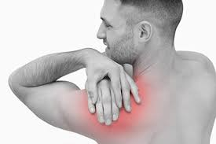
What does stress look like?
For many of us, stress is manifested through tight muscles and pain in the neck, shoulders, and back…
Notes:
For many of us, stress is manifested through tight muscles and pain in the neck, shoulders, and back. Our whole body can feel achy and tense at the end of day. If you looking for a simple but effective way to manage some of the physical effects of stress look no further. This workshop focuses on slow gentle stretches that help to unwind muscular knots and improve circulation. Stretches will occur while participates are seated or standing. Street wear is appropriate during this session and all fitness levels are welcome.

Slide 6
Benefits of Chair Yoga
1. Improves Strength
2. Improves Flexibility
3. Improves proprioception
Proprioception is the skill of knowing where your body is in space and coordinating your movements accurately. This is practice allows you to have control over your body.
4. Reduces stress and improved mental clarity
5. Improves stress and pain management
Yoga (in general) has many core benefits such as stress management, pain management, circulatory health, improved respiration, flexibility overall mindfulness of body and mind and much more!(American Osteopathic Association)

Slide 7
Benefits of Chair Yoga for College Students:
Use in stressful situations where you can't stretch. (i.e. library or home office)
Helps to revive and energize during long study sessions
No special clothes required
Oxygenates your blood and brain (oxygenated brain cells help with memory retention!)
Calms your brain by giving it a new focus
New knowledge to share with friends and family

Slide 8
1 min warm up
https://www.doyou.com/6-benefits-of-chair-yoga-8-poses-to-get-you-started/

Slide 9
Upper trapezius stretch –Neck (10-15 sec. holds)
Source: Best Health Magazine, September 2008; Illustration by Kagan McLeod. https://www.besthealthmag.ca/best-you/stretching/upper-trapezius-stretch/
Notes:
More than 25 per­cent of the population experiences neck pain-and it’s more common in women than men. To fend off this ache, try stretching your trapezius-the kite-shaped muscle that covers the upper and back part of the neck and the shoulders-a few times a day.
Stretch: Sitting up straight, with your feet flat and shoulders back, grab onto the bottom of your chair with your right hand. Then slowly tilt your head sideways, bringing your left ear toward your left shoulder until you feel a gentle stretch along the right side of your neck and shoulder. Hold for 10 to 15 seconds; repeat on the opposite side. Do this stretch a few times a day to help prevent a strain from starting in the first place.

Slide 10
Wrist flexor stretch (15 sec. holds, 4x each wrist)
Source: Best Health Magazine, Nov/Dec 2008; Illustration by Kagan McLeod https://www.besthealthmag.ca/best-you/stretching/wrist-flexor-stretch/
Notes:
Overuse injuries of the wrist are pretty common, and tend to affect people between the ages of 30 and 50. They can be caused at work or at play by repetitive gripping and grasping movements.
Stretch: While seated, extend your right arm forward at shoulder height. Keeping your elbow straight, grasp your right hand with your left, and slowly bend the wrist backward until you feel a stretch along the bottom of your forearm. Hold for 15 seconds. Then bend wrist downward until a stretch is felt on the top of the arm, and hold for 15 seconds. Switch arms and repeat. Repeat four times for each hand.

Slide 11
Prayer stretch (5 sec. holds, 5x)
Source: Best Health magazine, Jan/Feb 2013; Illustration: Kagan McLeod https://www.besthealthmag.ca/best-you/stretching/prayer-stretch/
Notes:
You probably don’t often think about stretching your wrists, but it’s important for maintaining good circulation.
Stretch: Place palms together, fingers straight, in a prayer position, elbows pointed out to your sides. Keeping the heels of the hands together, slowly lower hands and raise elbows so the angle at the wrist decreases. Press palms and fingers together firmly for five seconds, then release. Repeat five times.

Slide 12
Seated glute stretch ( 15-30 sec. holds each side)
Source: Best Health Magazine, Jan/Feb 2010; Illustration by Kagan McCleod https://www.besthealthmag.ca/best-you/stretching/seated-glute-stretch/
Notes:
For runners and walkers, stretching the gluteus maximus (butt muscles) improves flexibility and can help prevent injuries.
Stretch: Sit on a chair; bring one ankle up onto the knee of your other leg. Lean forward, keeping your back straight, and you should immediately feel the stretch in the gluteus maximus. Hold for 16 seconds. Continue forward as far as you can comfortably go, pushing gently on the top knee with your hand. Hold for 30 seconds, then switch sides.

Slide 13
Chair cat-cow stretch( 5 breaths)
Inhale arch
Exhale round spine
Check out guided exercise video here! >>
https://www.verywellfit.com/chair-yoga-poses-3567189
Notes:
Come to sit on a chair with the spine long and both feet on the floor. Place your hands on your knees or the tops of your thighs.
On an inhale, arch your spine and roll your shoulders down and back, bringing your shoulder blades onto your back. This is cow position.
On an exhale, round your spine and drop your chin to your chest, letting the shoulder and head come forward. This is cat position.
Continue moving between cow on the inhalations and cat on the exhalations for five breaths.

Slide 14
Chair Raised Hands Pose - Urdhva Hastasana
Inhale while raising arms
https://www.verywellfit.com/chair-yoga-poses-3567189
Notes:
On an inhalation, raise your arms toward the ceiling.
Maintain good upper body posture with the shoulders relaxed and rib cage sitting naturally over the hips. Anchor your sit bones in your chair seat and reach up from there.

Slide 15
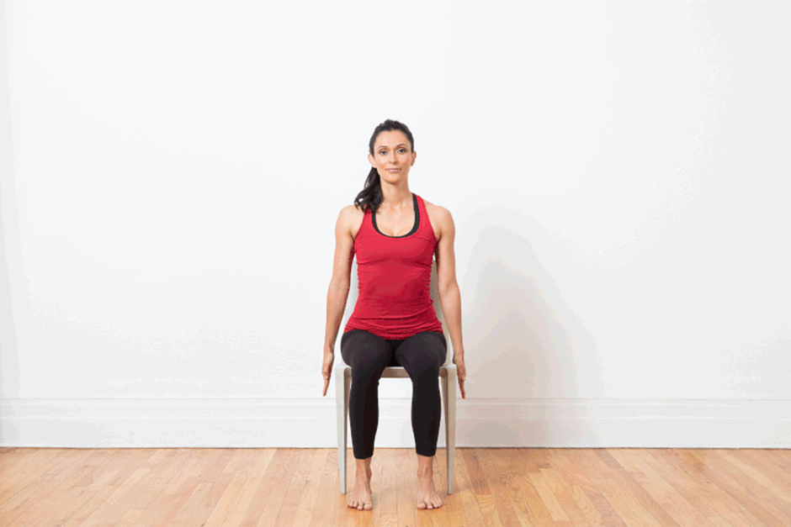
Chair Forward Bend - Uttanasana
Inhale
Exhale while bending forward
https://www.verywellfit.com/chair-yoga-poses-3567189
Notes:
On an exhalation, come into a forward bend over the legs.
Let the hands rest on the floor if they reach it. Let the head hang heavy.
On an inhalation, raise the arms back up over the head.
Repeat this movement between a raised arms position and a forward fold several times, moving with the breath.

Slide 16
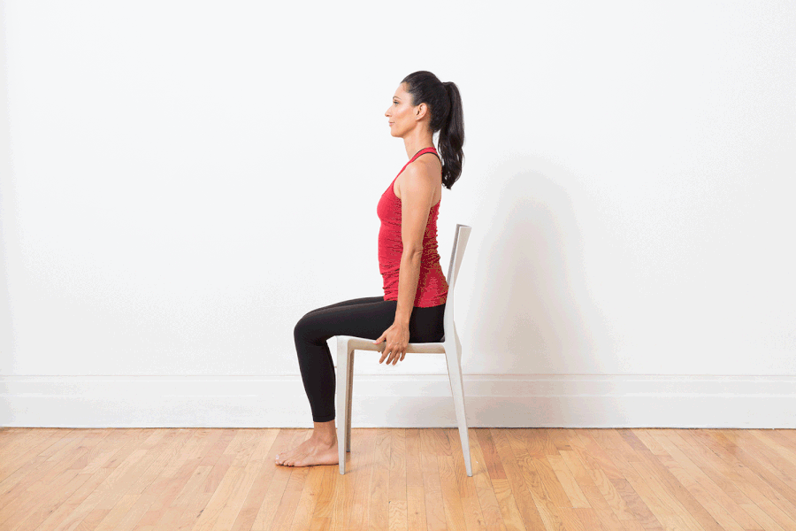
Chair Extended Side Angle - Utthita Parsvakonasana (3-5sec. breath holds)
https://www.verywellfit.com/chair-yoga-poses-3567189
Notes:
After your final forward bend, stay folded.
Bring your left fingertips to the floor on the outside of your left foot.
Open your chest as you twist to the right on an inhale, bringing your right arm and gaze up at the ceiling. This is your chair version of extended side angle pose. Hold here for several breaths. Bring the right arm down on an exhale.
If your left hand doesn't come easily to the floor, place a block under it or bring it to your left knee instead and twist from there.​
Do the same position with the right arm down and the left arm up.

Slide 17
Chair Pigeon - Eka Pada Rajakapotasana (3-5sec. breath holds)
https://www.verywellfit.com/chair-yoga-poses-3567189
Notes:
Come back up to sit.
Bring your right ankle to rest on your left thigh, keeping the knee in line with your ankle as much as possible. Hold this chair pigeon for three to five breaths.
You may forward bend to intensify the stretch if you like. Repeat with the left leg.

Slide 18
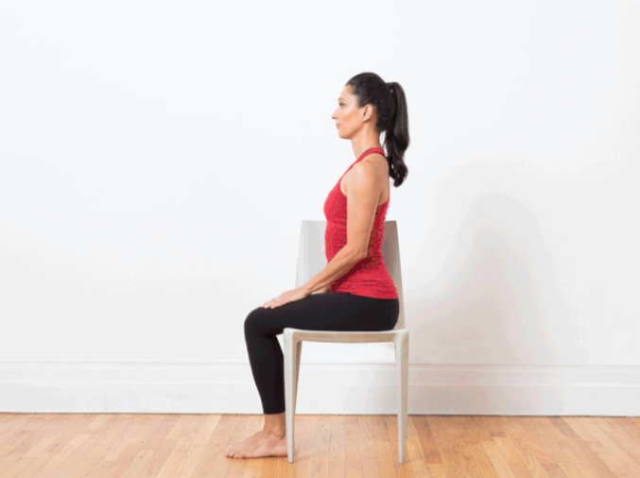
Chair Spinal Twist - Ardha Matsyendrasana (5 breaths)
Inhale
Exhale twist
https://www.verywellfit.com/chair-yoga-poses-3567189
Notes:
Come to sit sideways on the chair, facing to the left.
Twist your torso toward the left, holding onto the back of the chair, for a spinal twist.
Lengthen your spine on each inhale and twist on each exhale for five breaths.
Move your legs around to the right side of the chair and repeat the twist to the right side.

Slide 19
Seated Knee to Chest Stretch (15-20 sec. hold, 5x each side)
https://www.btod.com/blog/12-stretches-back-pain-desk/
Notes:
Seated Knee to Chest Stretch
While sitting in a chair, raise one knee as if you are marching until you can reach it with your hands.
Use both hands to pull the bent knee up toward your chest until you feel a gentle stretch in the lower back and back of the hip.
Your hands can be on top of your knee or behind your knee for comfort.
Hold this position for 15-20 seconds, then repeat 3-5 times on each side.

Slide 20
Seated Lateral Trunk Stretch (15-20sec. Holds, 5x each side)
https://www.btod.com/blog/12-stretches-back-pain-desk/
Notes:
Seated Lateral Trunk Stretch
While in a seated position, raise one arm over your head.
Place your other hand on your thigh for support.
Slowly bend to the opposite side until you feel a comfortable stretch along the side of your trunk.
Hold the stretch for 15-20 seconds, then repeat 3-5 times on each side.

Slide 21
Seated Hamstring Stretch (20-30 sec. holds, 4x each leg)
https://www.btod.com/blog/12-stretches-back-pain-desk/
Notes:
Seated Hamstring Stretch
While seated, rest your heel on the floor with your knee straight.
Gently lean forward until a stretch is felt behind your knee/thigh.
You should keep your low back straight to focus the stretch on the hamstring muscles.
Hold the stretch for 20-30 seconds, then repeat 3-4 times on each leg.

Slide 22
Final Relaxation: Chair Savasana (3-5 minutes)
https://www.verywellfit.com/chair-yoga-poses-3567189
Notes:
Take a few minutes to sit with your eyes closed and hands in your lap at the end of your practice. This seated savasana will help your body absorb all the good effects of the poses you have done and transition you into the rest of your day.

Slide 23
Caring for your body and your brain
Eat real food (nourishes body)
Take a multivitamin (supports overall health)
Exercise 3 times a week (reduces cortisol)
Take B-complex 100 (turns cortisol into energy)
Drink 60 ounces of water (hydrates / energizes)
Get at least 6 hours of sleep every night(improves cognition / decreases cortisol)

